Slide 1
Machine Learning on Seismic Streamer Data
Ellory Freneau

Slide 2
Marine Seismic Reflection Surveys
What are seismic reflection surveys? [1]
Determine geologic structure through the measurement of acoustic waves.
Steps:
1. Create an impulse.
2. Measure response.
3. Infer structure through processing response.
[1] https://www.sciencedirect.com/science/article/pii/B9780444534460000136

Slide 3
Purpose
What is the data used for? [1]
Mapping the sea floor.
See structure in the earth’s crust.
Mainly for gas exploration.
[1] https://www.sciencedirect.com/science/article/pii/B9780444534460000136

Slide 4
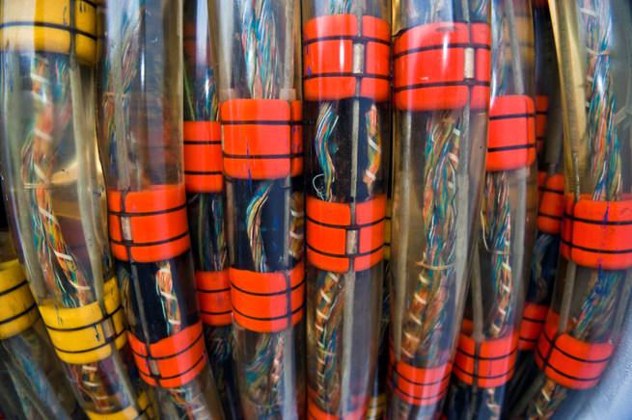
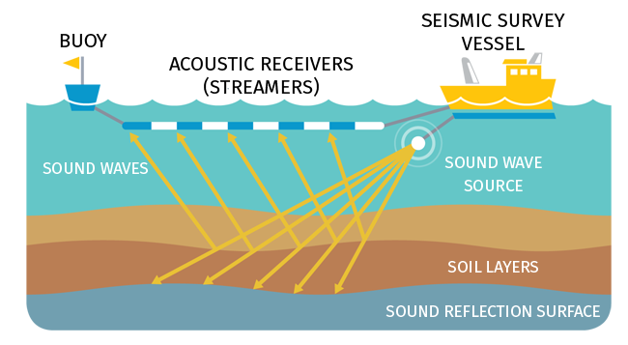
The Experiment
How are experiments conducted?
[2] https://commons.wikimedia.org/wiki/File:Streamer-detail_hg.jpg
[3] https://infograph.venngage.com/p/100165/seismic-survey-poster

Slide 5
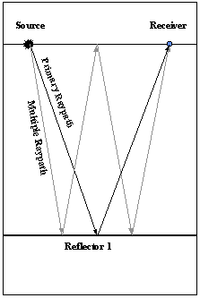
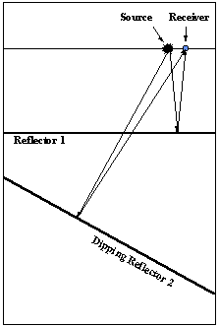
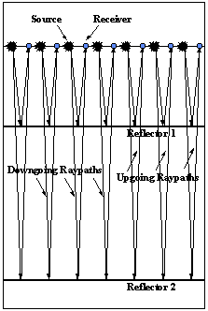
Interpreting Reflections
What does data tell us? [4]
[4] https://www.ucl.ac.uk/EarthSci/people/lidunka/GEOL2014/Geophysics4 - Seismic waves/Seismology/An Introduction to Reflection Seismology Data Processing.htm

Slide 6
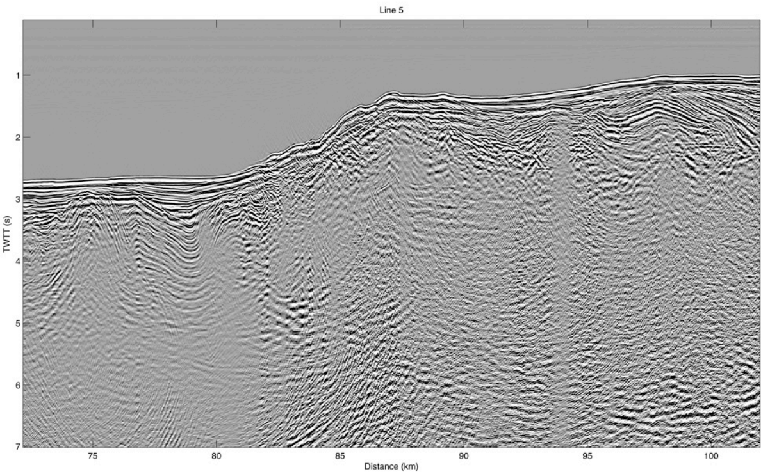
Seismic Reflection Application
[5] https://steveholbrook.com/research/cascadia2d/coast_cruise_report.pdf

Slide 7
Environmental Impact
How much noise is being emitted? How is wildlife effected?
Marine mammals use sound to communicate.
Loud sounds effect their behavior.
Deadly at certain ranges.
Important to estimate impact.

Slide 8
Project Goal
Estimate the impact of reflection surveys on marine mammals from publicly available data sets.

Slide 9
Steps
Preprocess raw hydrophone data.
Compute sound metrics.
Apply linear regression and random forest.
Compare results to other models.

Slide 10
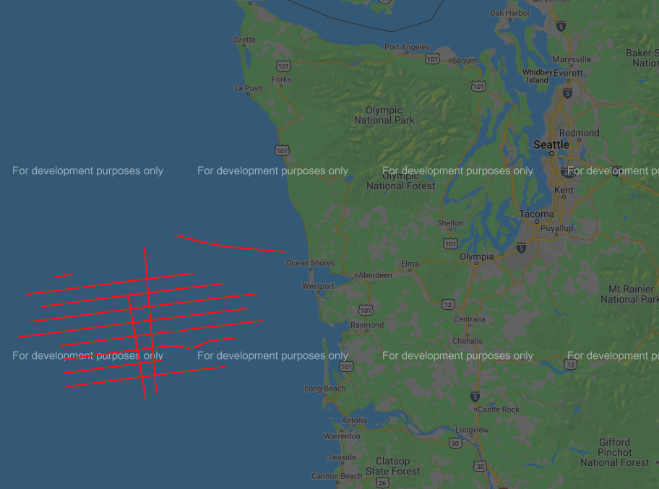
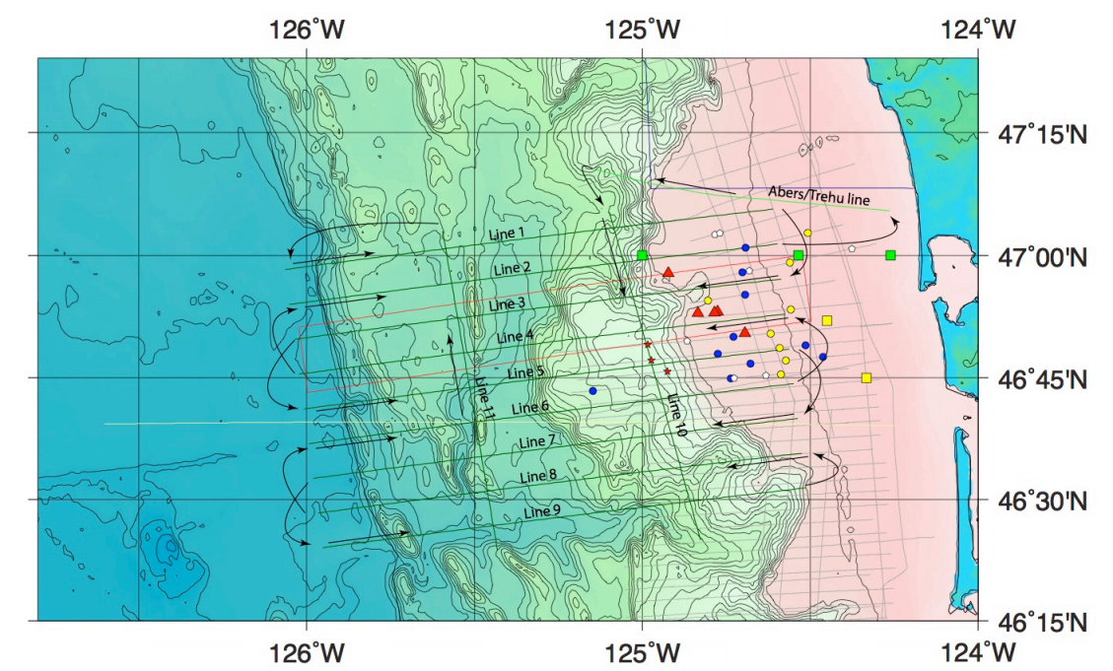
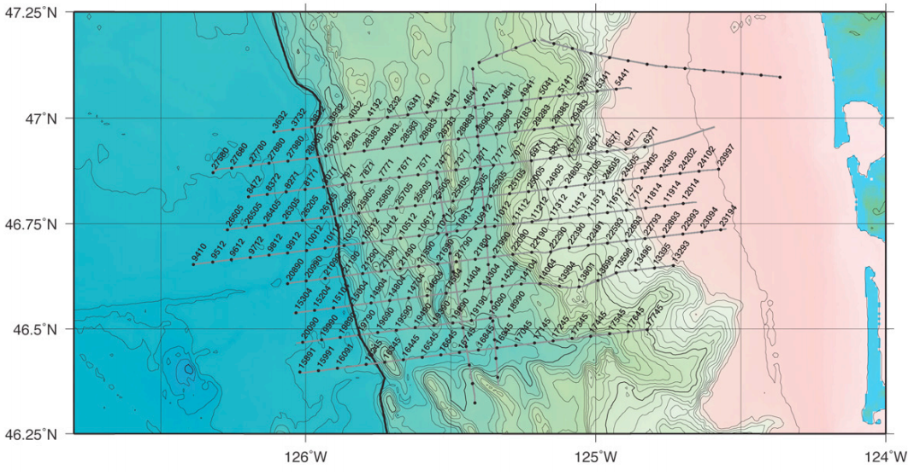

Data – Cruises, Lines and Shots
Where does the data come from? How is it organized? [5]
[5] https://steveholbrook.com/research/cascadia2d/coast_cruise_report.pdf

Slide 11
Data – Single Shot
What data is recorded during a shot?
636 Hydrophones (over 8.5 km/5.3 mi).
16 seconds, Fs=500 Hz. double64.
636x8192 matrix per shot.
UTM coordinates of each hydrophone.
Other data sets (magnetism, salinity, gravity etc.)

Slide 12
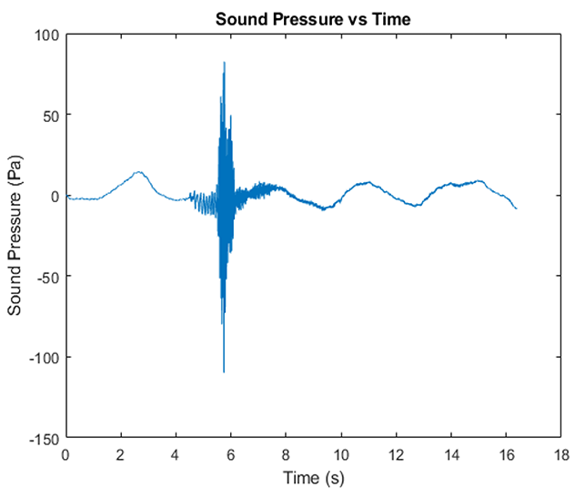
Time Series Analysis
Sound Pressure over Multiple Hydrophones
[6] Abadi, S. H., & Freneau, E. (2019). Short-range propagation characteristics of airgun pulses during marine seismic reflection surveys. The Journal of the Acoustical Society of America, 146(4), 2430–2442. https://doi.org/10.1121/1.5127843.
Notes:
Line 7: 443
1500 m/s

Slide 13
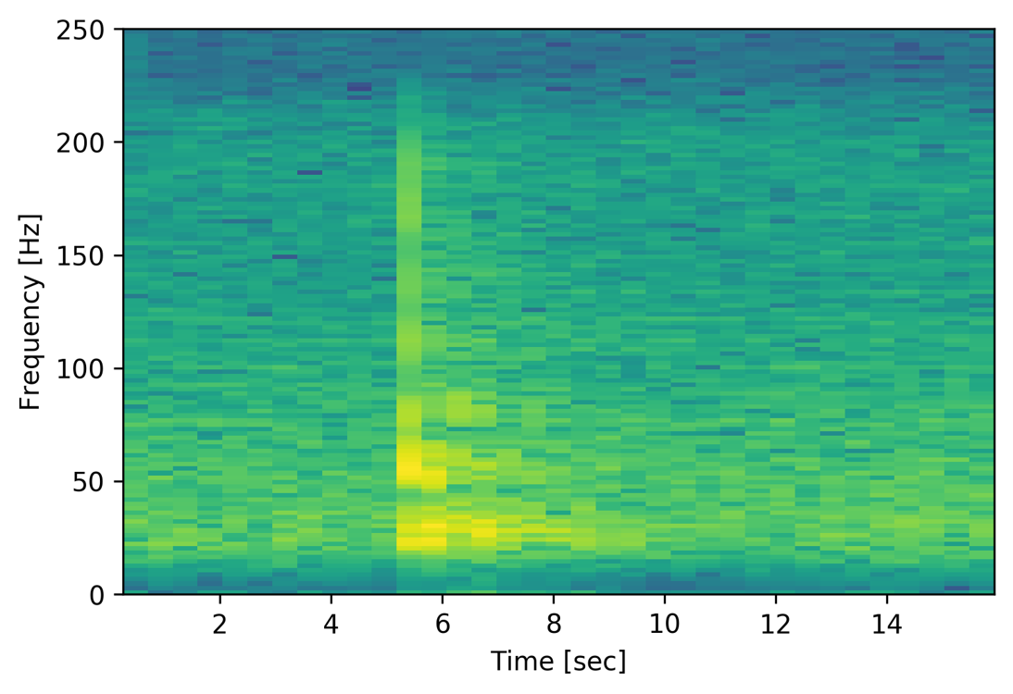
Time-Frequency Analysis
Notes:
Line 7: 443
1500 m/s

Slide 14
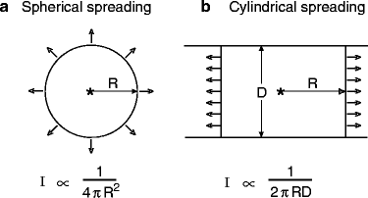
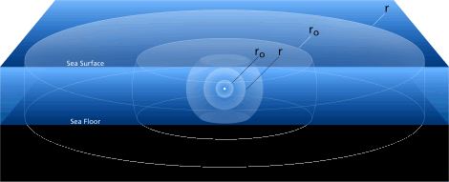
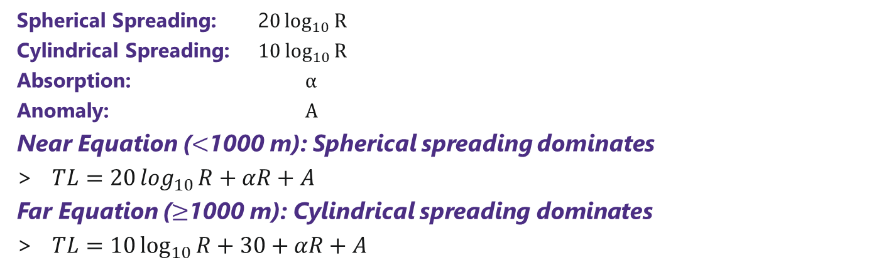
Transmission Loss
How far does sound travel? [4][5]
Spherical Spreading: 2$0\log_{10}{R}$
Cylindrical Spreading: $10\log_{10}{R}$
Absorption: $α$
Anomaly: $A$
Near Equation ($<$1000 m): Spherical spreading dominates
$TL=20\log_{10}{R}+αR+A$
Far Equation ($≥$1000 m): Cylindrical spreading dominates
$TL=10\log_{10}{R}+30+αR+A$
[7] Jensen, Finn B., et al. “Fundamentals of Ocean Acoustics.” Computational Ocean Acoustics, by Finn B. Jensen et al., Springer New York, 2011, pp. 1–64. DOI.org (Crossref), doi:10.1007/978-1-4419-8678-8_1.
[8] https://dosits.org/science/advanced-topics/cylindrical-vs-spherical-spreading/

Slide 15
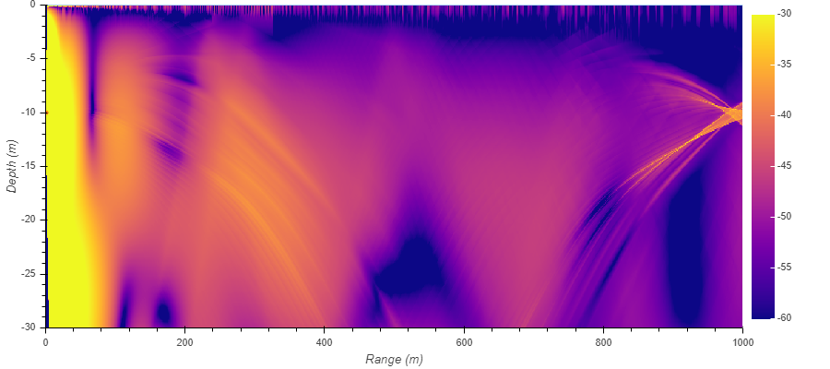
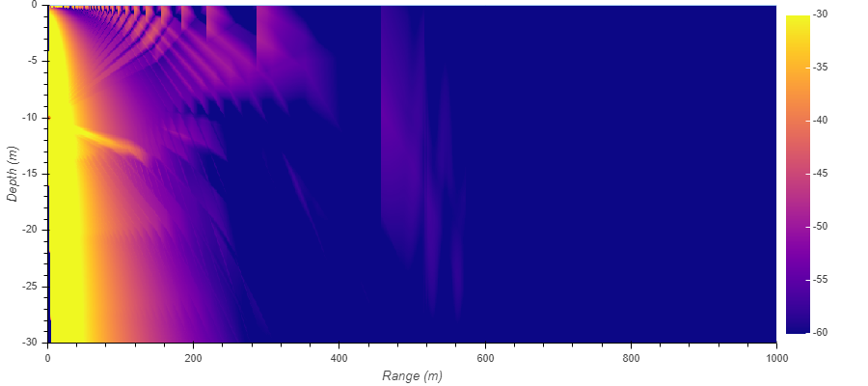
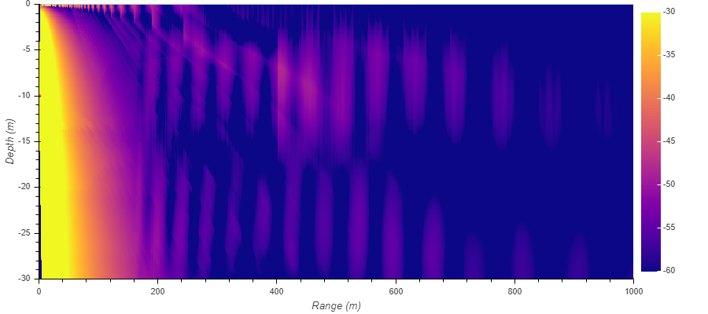
Effect of Depth (TL)
Shallow (< 100m)
TL Simulations (BELLHOP)
Deep (> 1000m)
Intermediate (100-1000m)
Notes:
bokeh

Slide 16
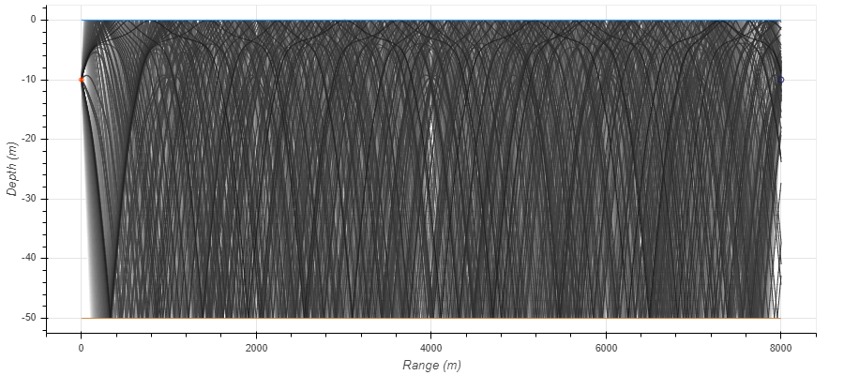
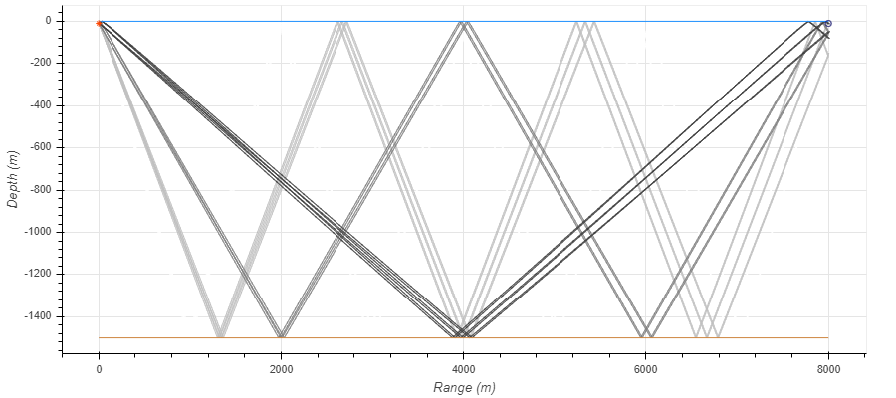
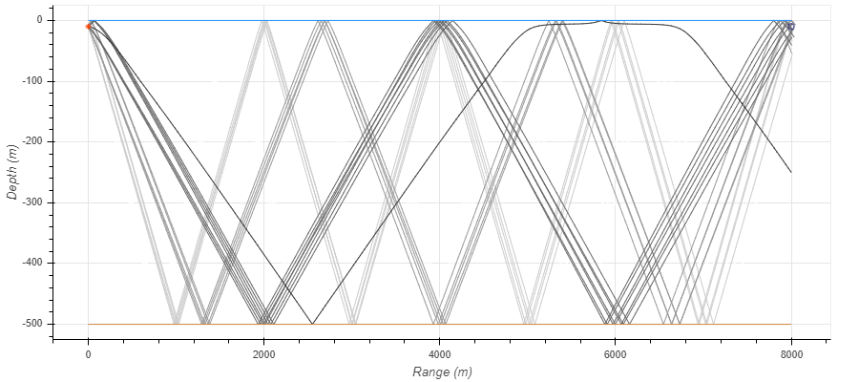
Effect of Depth (Rays)
Shallow (< 100m)
Ray Path Simulations (BELLHOP)
Deep (> 1000m)
Intermediate (100-1000m)
Notes:
bokeh

Slide 17
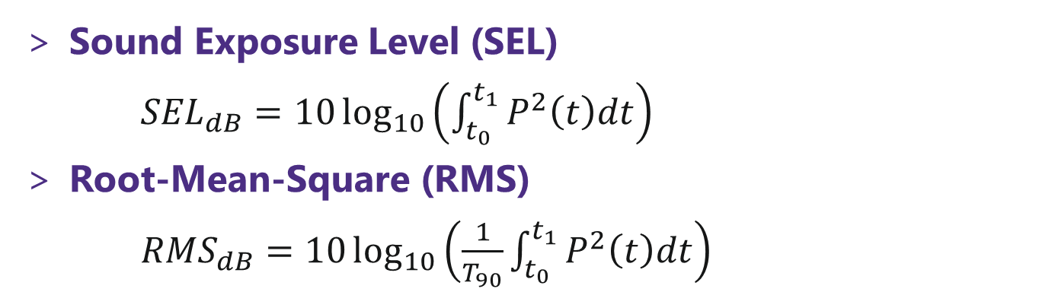
Sound Level
How loud are emissions?
Sound Exposure Level (SEL)
${SEL}_{dB}=10\log_{10}\left(\int_{t_{0}}^{t_{1}}{P^{2}\left(t\right)dt}\right)$
Root-Mean-Square (RMS)
${RMS}_{dB}=10\log_{10}\left(\frac{1}{T_{90}}\int_{t_{0}}^{t_{1}}{P^{2}\left(t\right)dt}\right)$

Slide 18
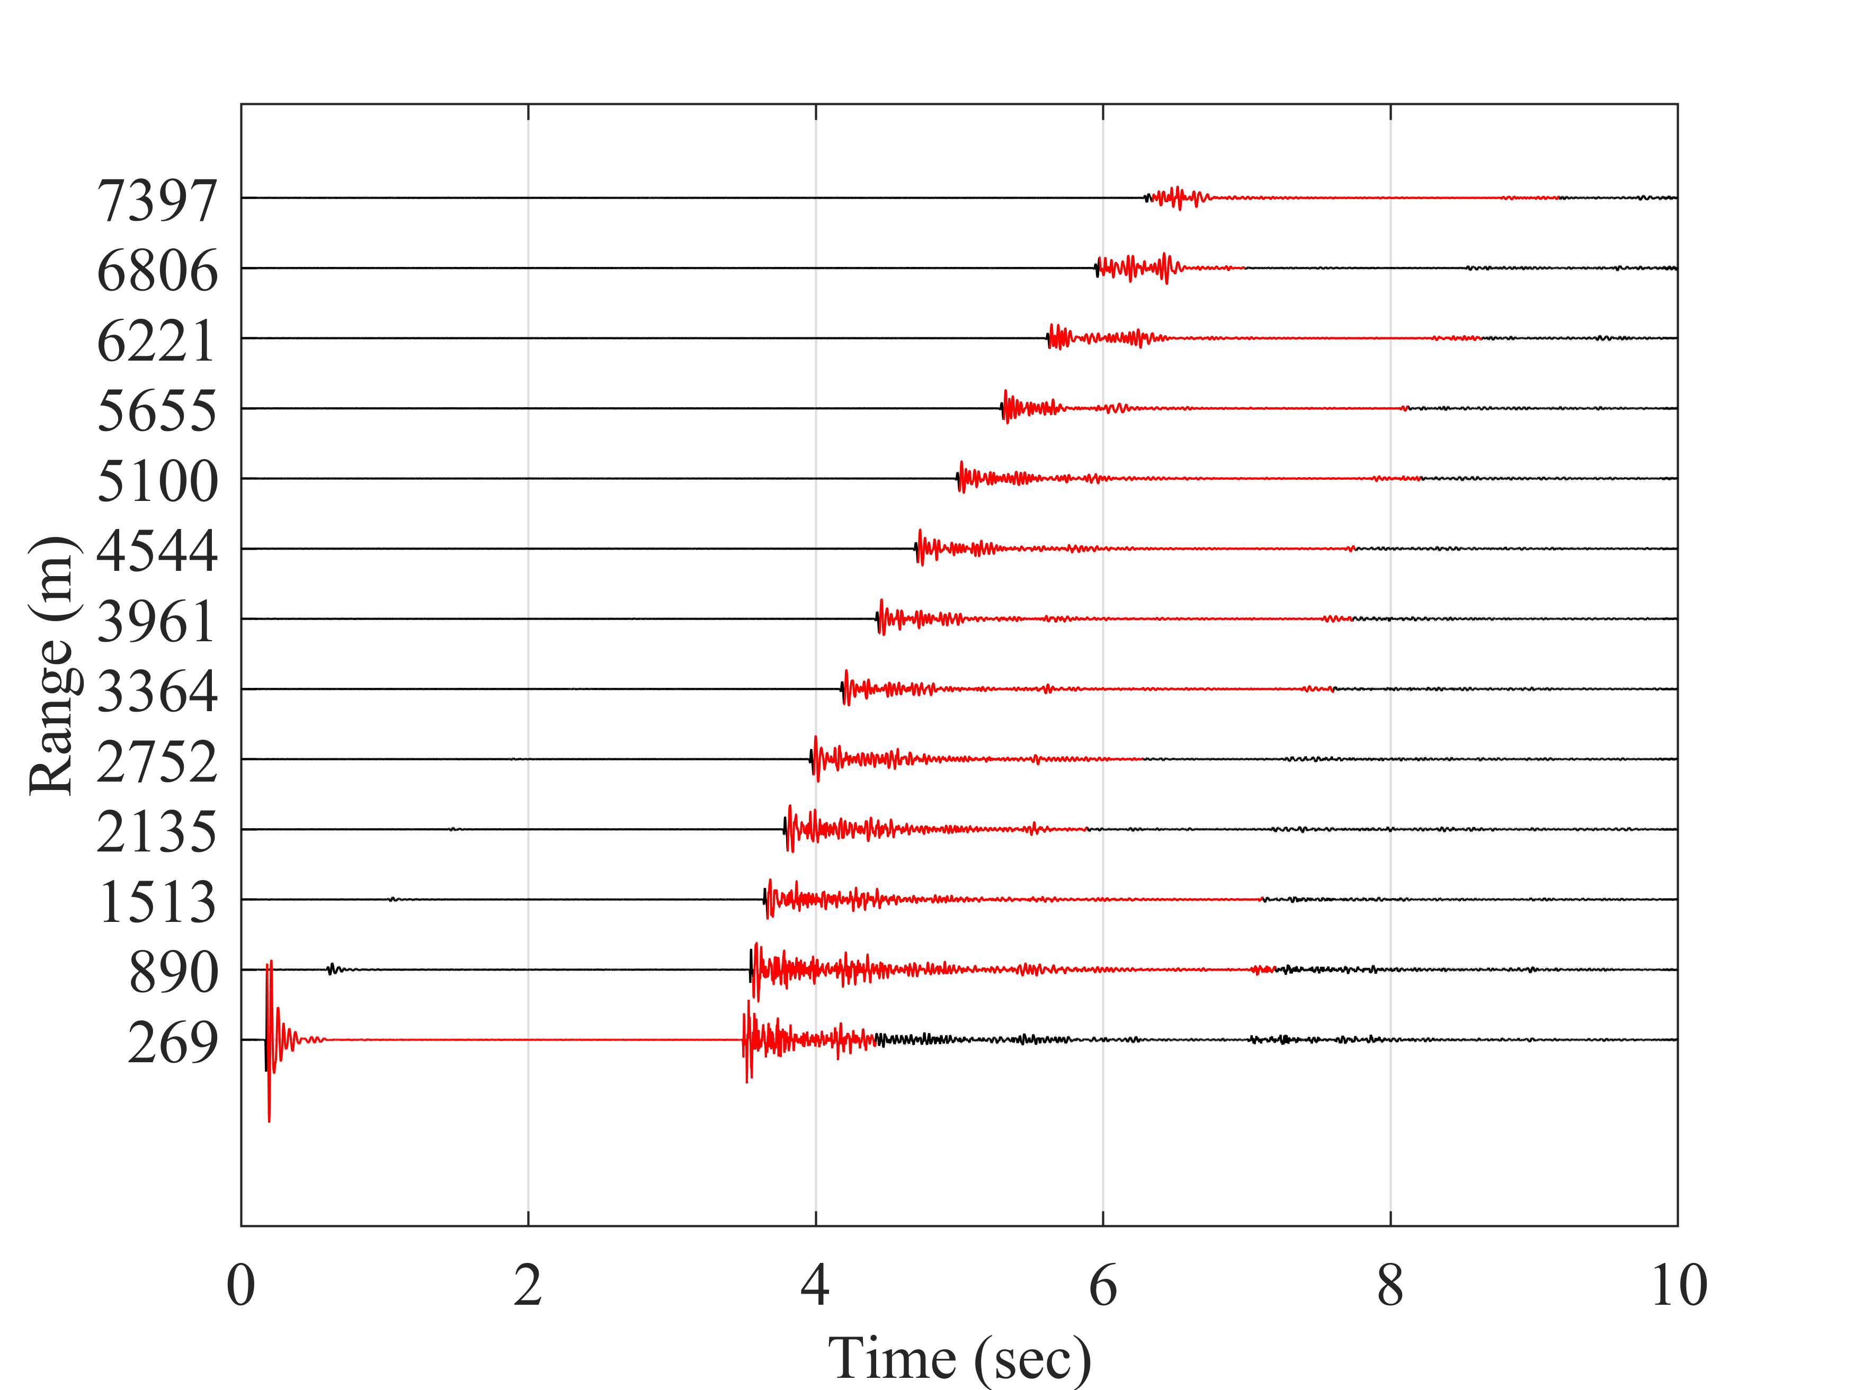
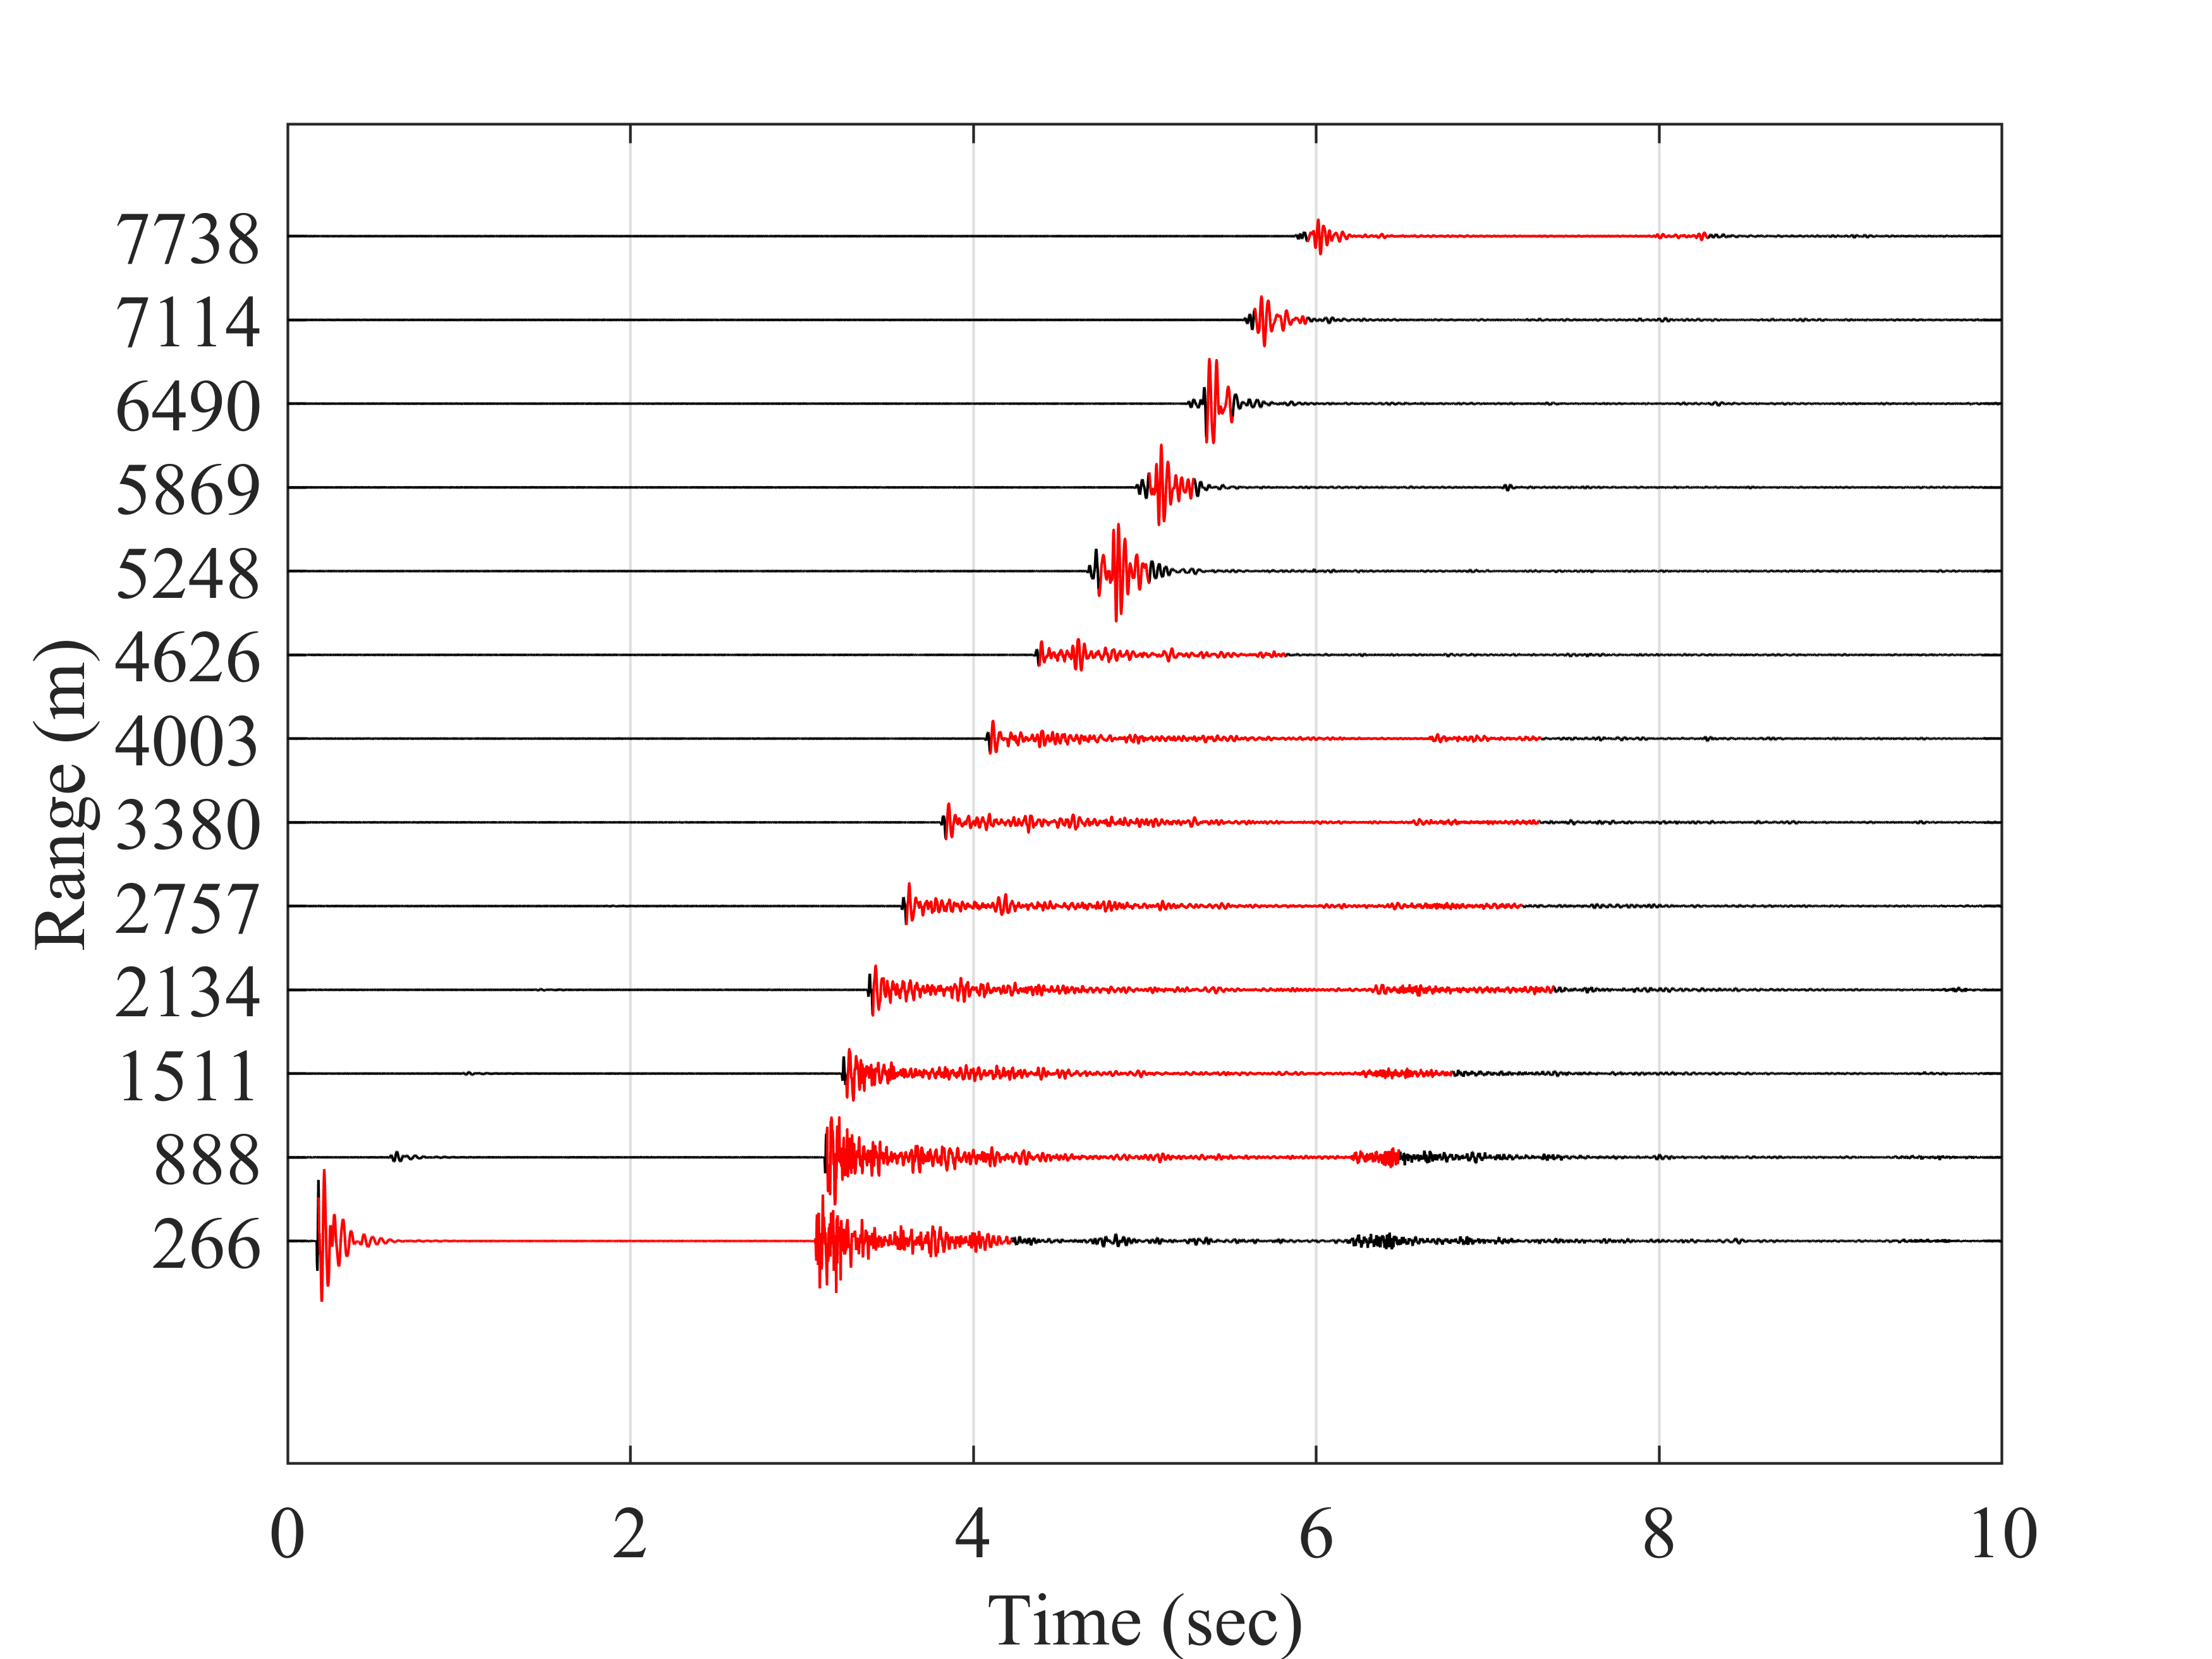
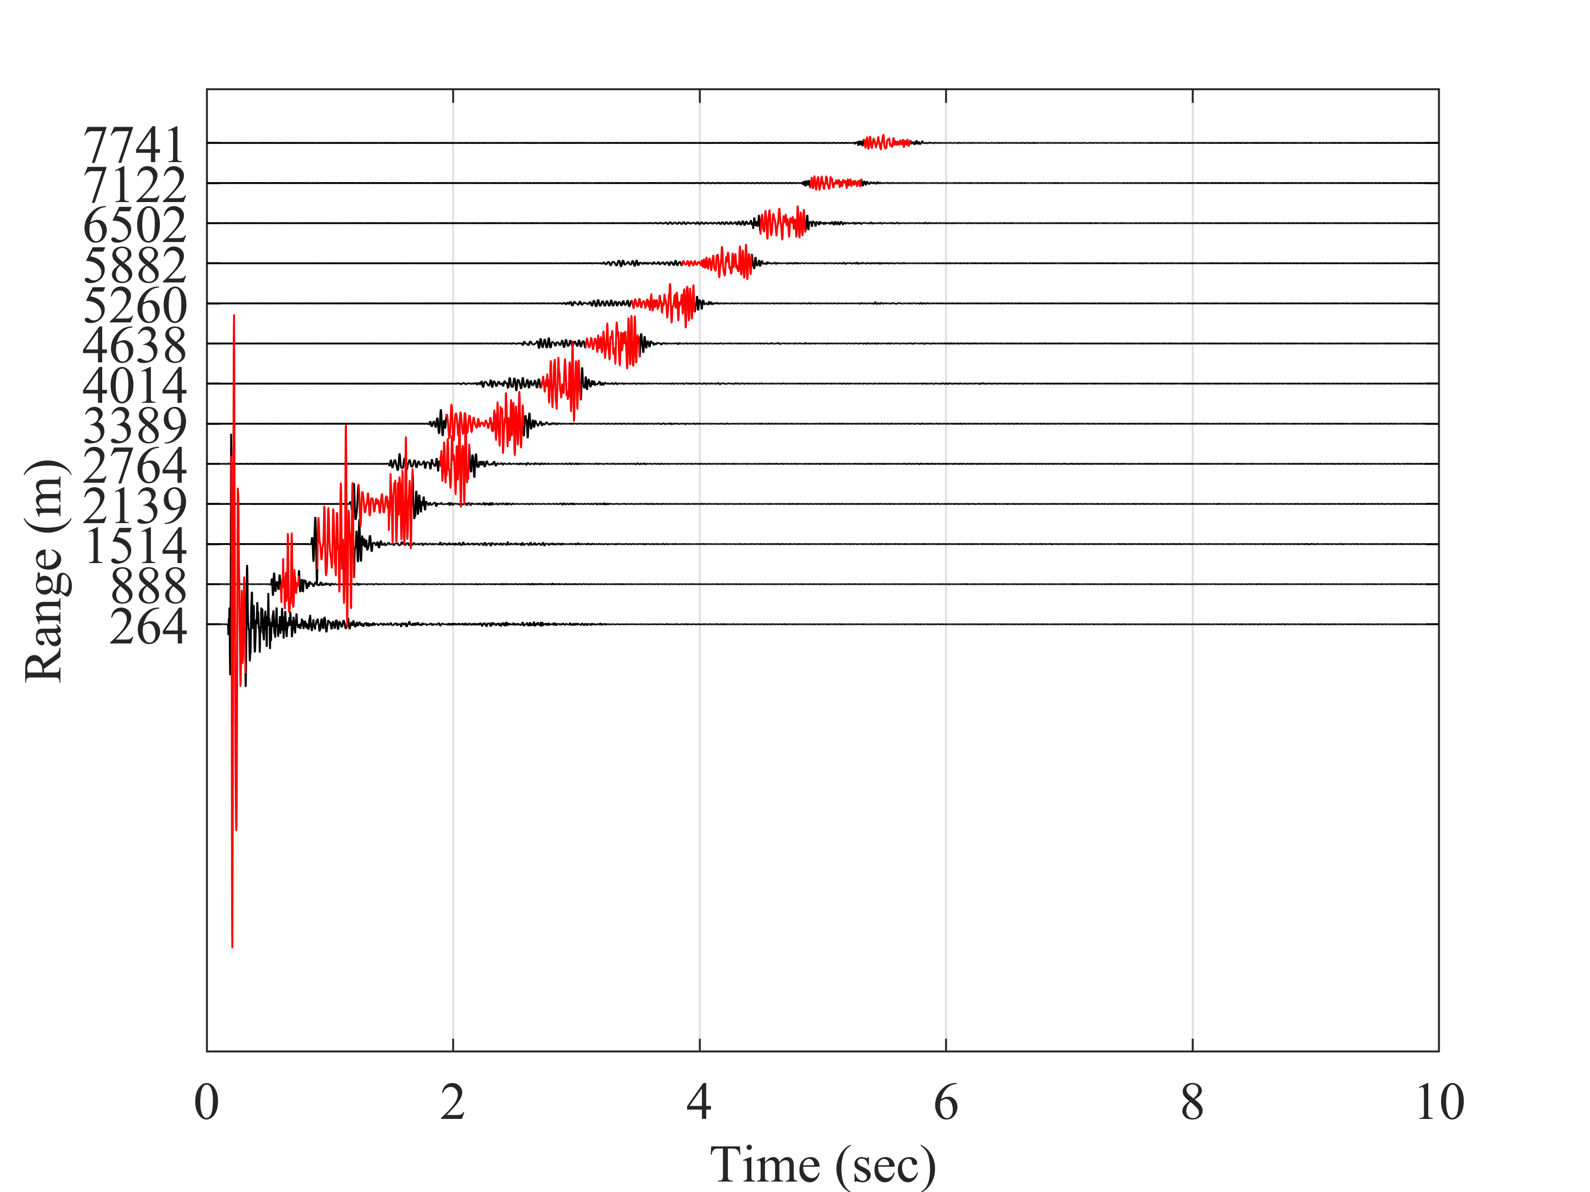
90% Energy Window (T90)
Shallow (< 100m)
Intermediate (100-1000m)
Deep (> 1000m)

Slide 19
Frequency Content
[9] S. Abadi and E. Freneau, "Spectral Analysis of Airgun Pulses During Marine Seismic Reflection Surveys," OCEANS 2019 MTS/IEEE SEATTLE, Seattle, WA, USA, 2019, pp. 1-5. doi: 10.23919/OCEANS40490.2019.8962817.

Slide 20
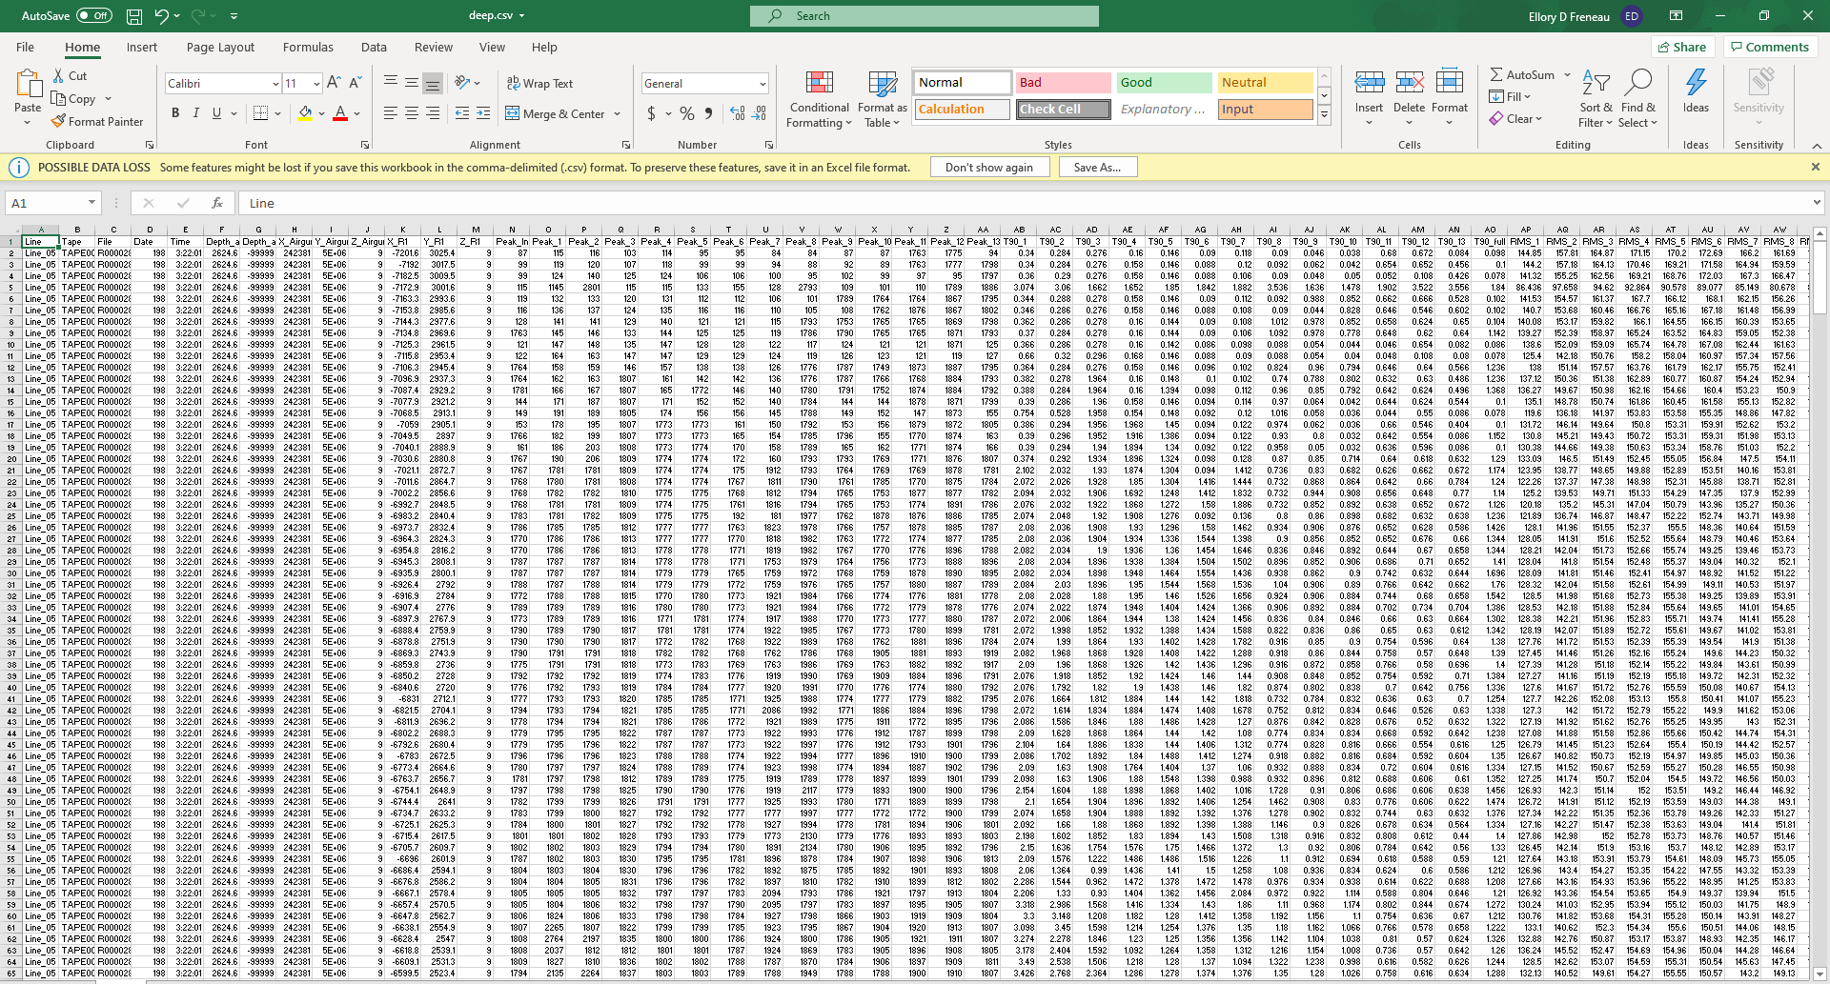
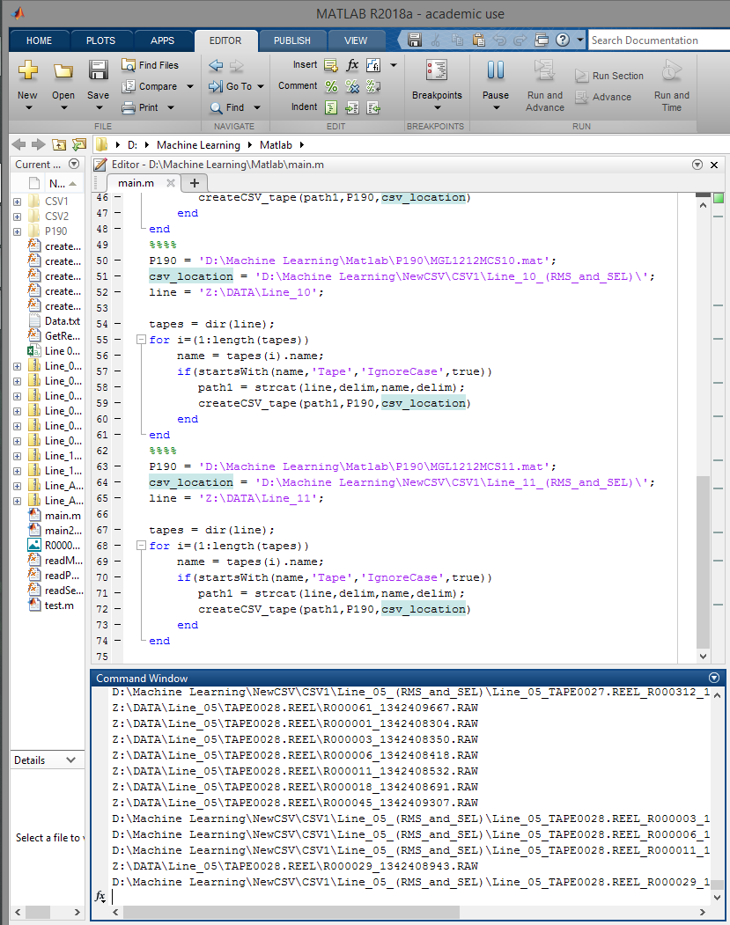
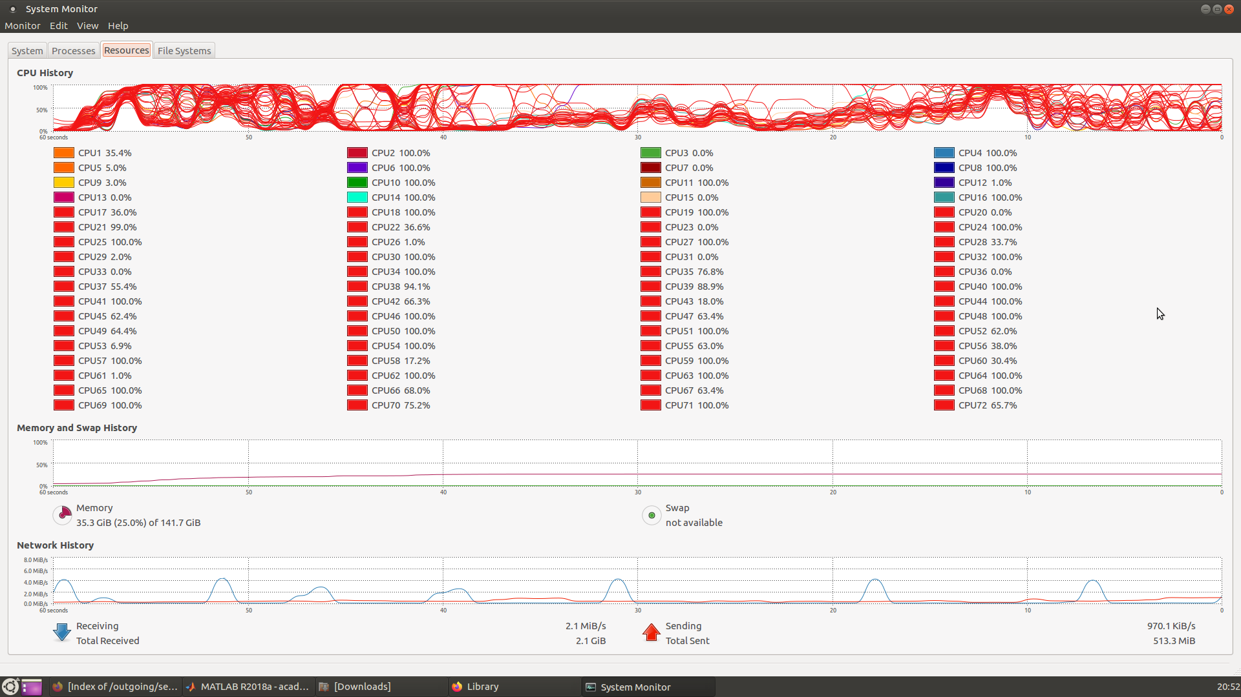
Preprocessing and Storage

Slide 21
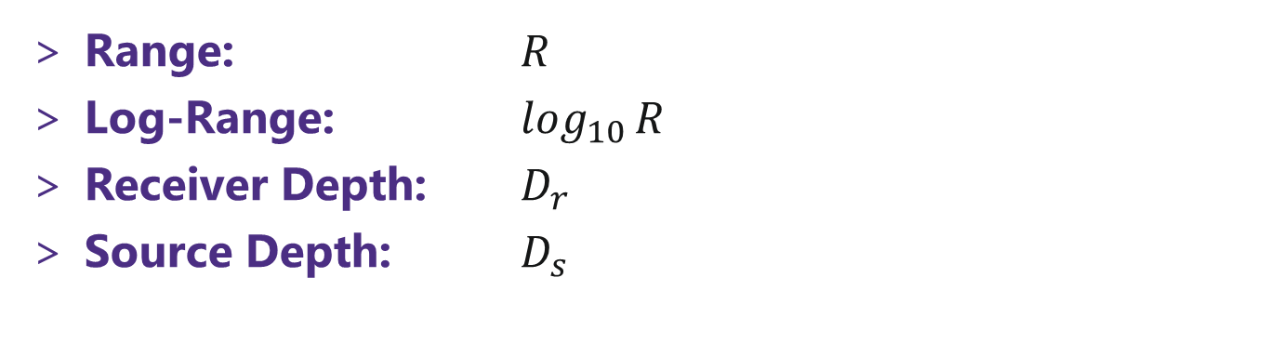
Features
What information is important for modeling SEL?
Range: $R$
Log-Range: $\log_{10}{R}$
Receiver Depth: $D_{r}$
Source Depth: $D_{s}$

Slide 22
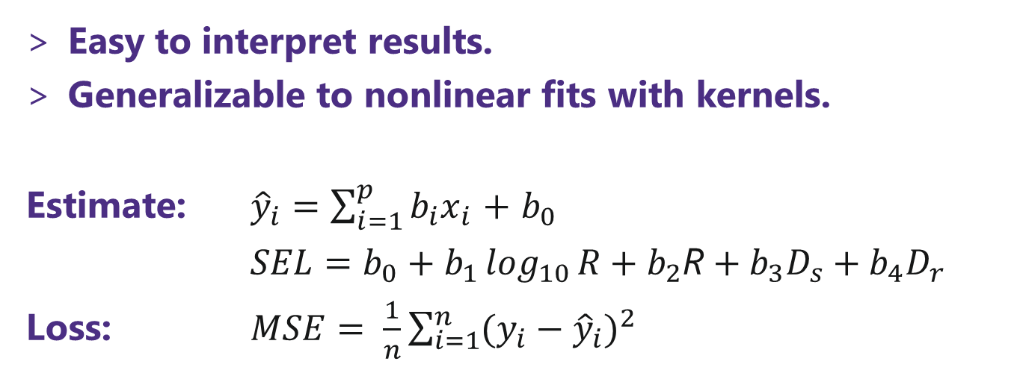
Method: Linear Regression
Easy to interpret results.
Generalizable to nonlinear fits with kernels.
Estimate: ${\hat{y}}_{i}=\sum_{i=1}^{p}{b_{i}x_{i}}$ $+$ $b_{0}$
$SEL=b_{0}+b_{1}\log_{10}{R}+b_{2}\text{R}+b_{3}D_{s}+b_{4}D_{r}$
Loss: $MSE= \frac{1}{n}\sum_{i=1}^{n}{{(y_{i}−{\hat{y}}_{i})}^{2}}$

Slide 23
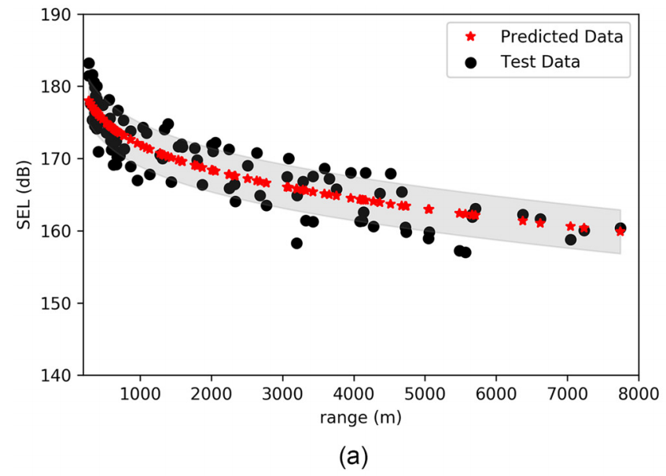
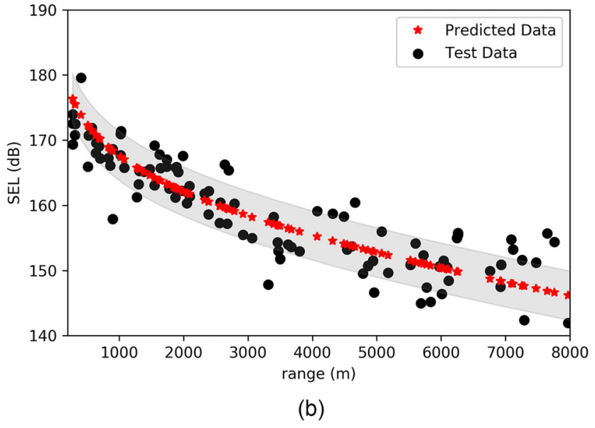
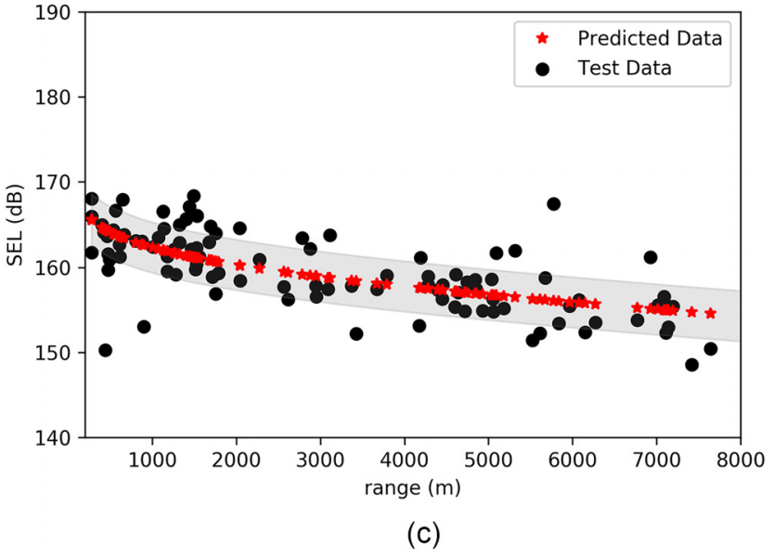
RESULTS: Linear Regression
[6] Abadi, S. H., & Freneau, E. (2019). Short-range propagation characteristics of airgun pulses during marine seismic reflection surveys. The Journal of the Acoustical Society of America, 146(4), 2430–2442. https://doi.org/10.1121/1.5127843.

Slide 24
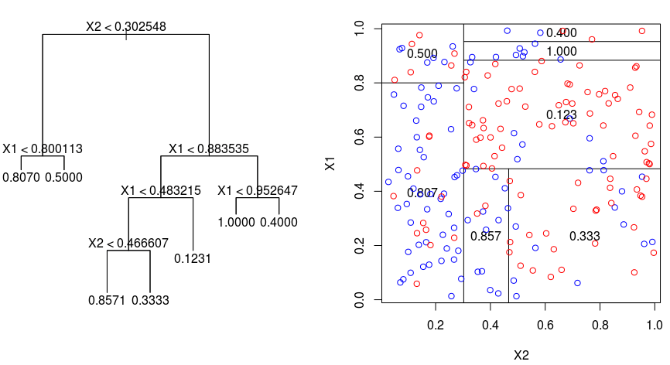
Method: Random Forest
Robust to overfitting (bagging).
Built in feature selection.
[10] https://gdcoder.com/decision-tree-regressor-explained-in-depth/

Slide 25
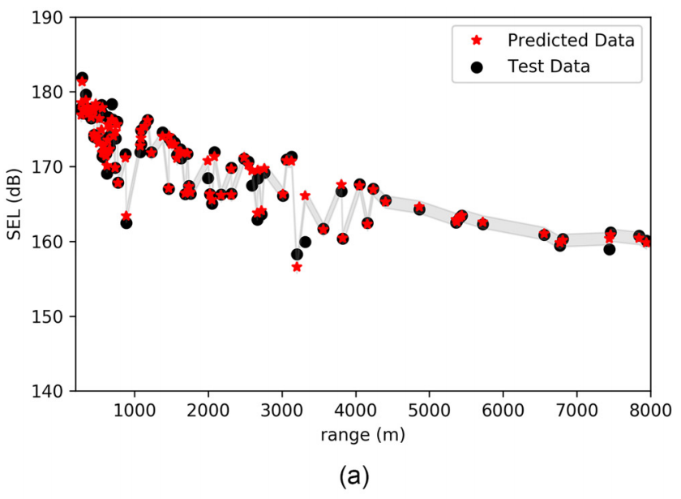
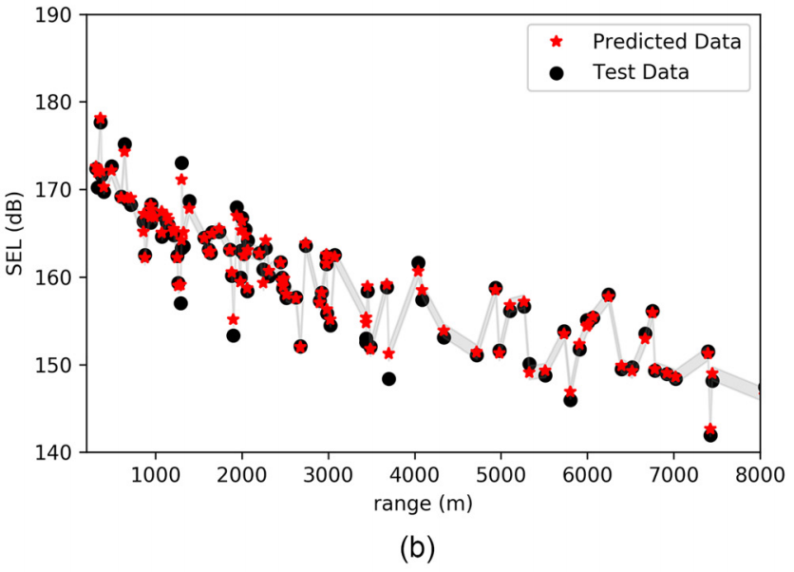
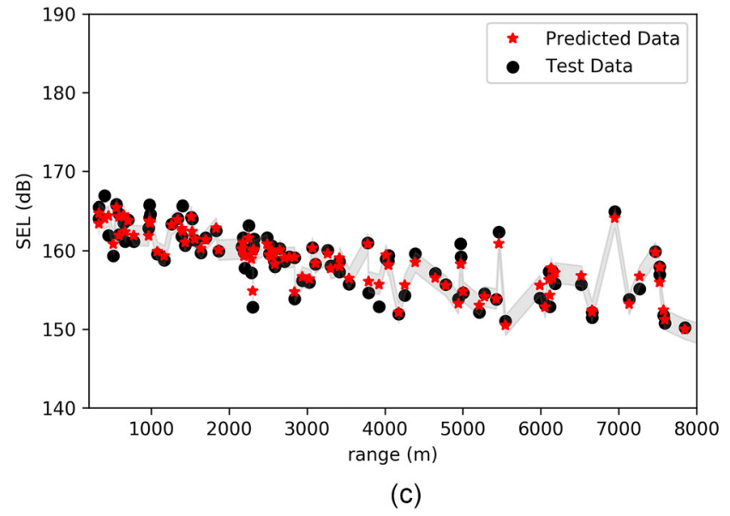
RESULTS: Random Forest
[6] Abadi, S. H., & Freneau, E. (2019). Short-range propagation characteristics of airgun pulses during marine seismic reflection surveys. The Journal of the Acoustical Society of America, 146(4), 2430–2442. https://doi.org/10.1121/1.5127843.

Slide 26
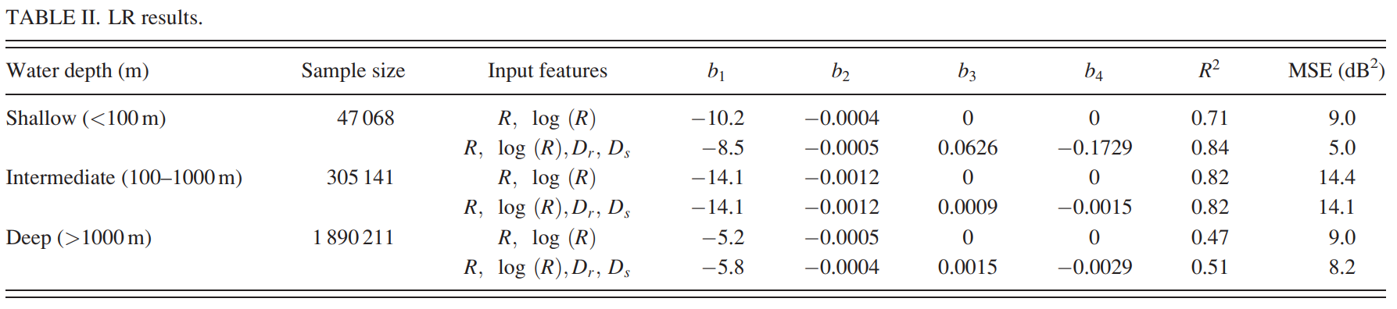
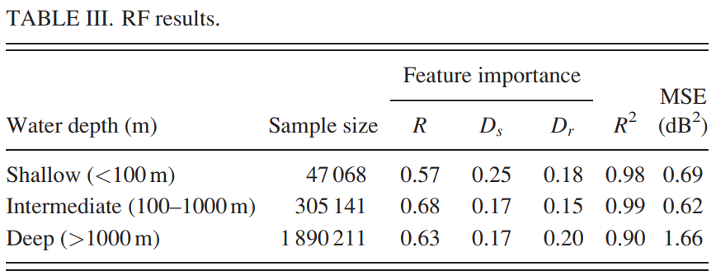
RESULTS: Comparison of LR and RF
[6] Abadi, S. H., & Freneau, E. (2019). Short-range propagation characteristics of airgun pulses during marine seismic reflection surveys. The Journal of the Acoustical Society of America, 146(4), 2430–2442. https://doi.org/10.1121/1.5127843.

Slide 27
Future Work
Analysis of Minimum Level Metrics (reverberation).
Analysis of frequency.
Add option for storing processed data in an SQL database.

Slide 28

QUESTIONS?
Published Results:
Abadi, S. H., & Freneau, E. (2019). Short-range propagation characteristics of airgun pulses
during marine seismic reflection surveys. The Journal of the Acoustical Society of America,
146(4), 2430–2442. https://doi.org/10.1121/1.5127843.
Project Repo:
https://github.com/efreneau/Machine-Learning-On-Seismic-Streamer-Data

Slide 29
Sources
[1] https://www.sciencedirect.com/science/article/pii/B9780444534460000136
[2] https://commons.wikimedia.org/wiki/File:Streamer-detail_hg.jpg
[3] https://infograph.venngage.com/p/100165/seismic-survey-poster
[4] https://www.ucl.ac.uk/EarthSci/people/lidunka/GEOL2014/Geophysics4 - Seismic waves/Seismology/An Introduction to Reflection Seismology Data Processing.htm
[5] https://steveholbrook.com/research/cascadia2d/coast_cruise_report.pdf
[6] Abadi, S. H., & Freneau, E. (2019). Short-range propagation characteristics of airgun pulses during marine seismic reflection surveys. The Journal of the Acoustical Society of America, 146(4), 2430–2442. https://doi.org/10.1121/1.5127843.
[7] Jensen, Finn B., et al. “Fundamentals of Ocean Acoustics.” Computational Ocean Acoustics, by Finn B. Jensen et al., Springer New York, 2011, pp. 1–64. DOI.org (Crossref), doi:10.1007/978-1-4419-8678-8_1.
[8] https://dosits.org/science/advanced-topics/cylindrical-vs-spherical-spreading/
[9] S. Abadi and E. Freneau, "Spectral Analysis of Airgun Pulses During Marine Seismic Reflection Surveys," OCEANS 2019 MTS/IEEE SEATTLE, Seattle, WA, USA, 2019, pp. 1-5. doi: 10.23919/OCEANS40490.2019.8962817.

